Slide 1

Learning Supported by Technology: Effectiveness with Educational Software
Sharon Tzur
Advisor: Prof. Nitza Davidovich and Dr Adi Katz
Faculty of Social Sciences and Humanities, Ariel University, Israel
May 2022
1

Slide 2




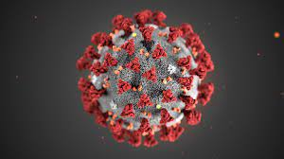
Background
Many technological means have been incorporated in recent decades
We examined the effectiveness of learning through Educational Software
The goal of the study
The uniqueness of the study
Corona epidemic

Slide 3
Literature Review
Schmeeckle (2003) - research compared instruction combining educational software and traditional instruction in class
Weisser (2016) - conducted a comparison between frontal learning in class and learning in two online environments
Rappel (2017) - found that in order to produce effective online learning it is necessary to combine social elements and collaborative learning

Slide 4
Theory
Bloom’s revised taxonomy (1956)
Apply,Understand ,Remember
Media Naturalness (Daft & Lengel, 1984)
Affective-Cognitive Model of Organizational Communication (Te’eni, 2015)
STEM (Davidovich & Shiler, 2016)

Slide 5
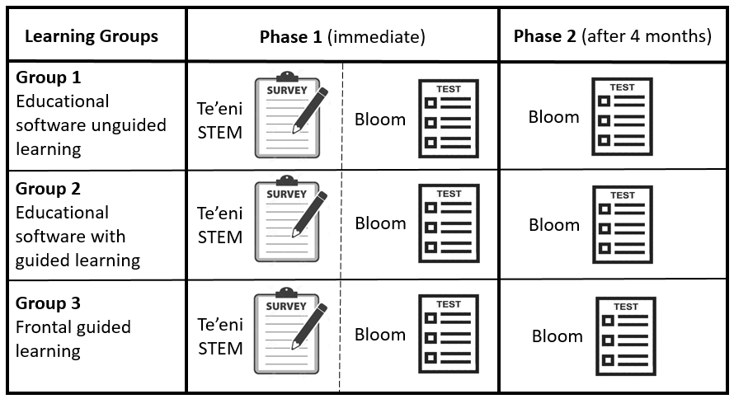
Methodology

Slide 6
Findings

Slide 7
Findings

Slide 8
Findings
0.36 = σ
0.35 = σ
0.77 = σ

Slide 9
Findings
0.24 = σ
0.35 = σ
0.54 = σ

Slide 10
Summary of test results Stage I
Level of Remember
Level of Understand
Level of Apply

Slide 11
Findings

Slide 12
Findings

Slide 13
Findings

Slide 14
Findings

Slide 15
Findings

Slide 16
Summary of test results Stage II
In all the tests there was erosion in the results after about 4 months
The highest level of erosion of Remember and Understand was when instruction was in the Educational software alone

Slide 17
Conclusions and recommendations
Training to the specific goals
level of Remember
level of understand and apply
Advantage of integrating a guide in the apply dimension
Educational software a static tool
Consider integration with other tools

Slide 18
Summary
The study examined the effectiveness of E-learning
The study gained sub-validity in dealing with the corona crisis
The recommendation was implemented and the training methods were adapted to the specific needs

Slide 19
Thanks for listening

