Slide 1



The Human Side of Teaching
Prof. Nitza Davidovitch, Ariel University, Israel
Head of Department of Education, Head of quality assessment and academic instruction and head of teacher training program

Slide 2

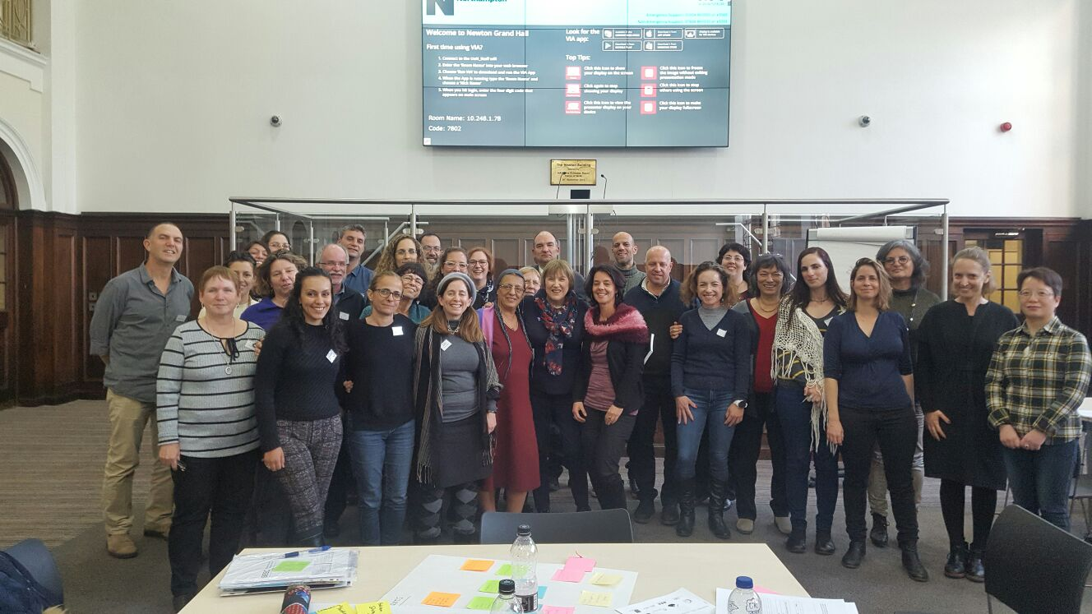
Forum of Centers for the Promotion of Teaching in Israel

Slide 3


Forum of Centers for the Promotion of Teaching in Israel
The Forum is engaged in academic-professional development in the field of academic teaching in higher education in Israel.
Forum members are also members of national and international organizations and groups that promote and advance teaching in higher education.

Slide 4

The Human Side of Teaching
How to transform “remote” to “near,” and how to transform this forced event to an opportunity that invites a significant learning experience.

Slide 5

E-Teaching and E-Learning In Times Of Crisis – An Incidental Or Facilitative Event?
This study is a quantitative study:
2,015 students
223 faculty in academic universities and colleges in Israel.
The aims of the study:
What do faculty and students think about the advantages and shortcomings of online teaching and learning after their experience, forced upon them by the COVID pandemic?
Do the views of students and faculty differ?
How and to what extent can the case of teaching and learning during the COVID pandemic predict future trends in teaching and learning in academic institutions?

Slide 6

E-Teaching and E-Learning In Times Of Crisis – An Incidental Or Facilitative Event?
The findings of the study indicate:
faculty and students hold similar views of online teaching and learning during the COVID pandemic.
The most significant advantage of online teaching, is the added flexibility for students in terms of their attendance, participation, attire, and other elements.
The question: to whether the issue is greater flexibility or reduced commitment?

Slide 7
E-Teaching and E-Learning In Times Of Crisis – An Incidental Or Facilitative Event?
The most significant shortcoming: the absence of meetings with classmates.
The learning experience typically encompasses social dimensions and interpersonal connections, which are absent in online distant learning.
This dimension of the experience is highly anticipated by students and constitutes a motivating factor that drives their learning. The opportunity and task of transforming a physical on-campus “learning community” into a virtual learning community depend on faculty efforts.

Slide 8
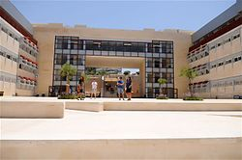
E-Teaching and E-Learning In Times Of Crisis – An Incidental Or Facilitative Event?
Our case study – Ariel University
How effective is this method (Zoom), and what insights have we gained about its future implementation?
A recent study explored students’ views on the benefits and shortcomings of online teaching and learning.

Slide 9

E-Teaching and E-Learning In Times Of Crisis – An Incidental Or Facilitative Event?
Study population: 1,400 students (52.7% male, 96% undergraduate students).
67.7% classified themselves as belonging to moderate socio-economic status but almost all respondents (90.3%) stated that they have the resources and tools necessary for online learning.

Slide 10
Respondents noted their agreement with a set of statements related to online teaching and learning.
Only 17% of respondents strongly agreed with the statement: “Online teaching methods improve learning ability.”
Only 13% strongly agreed with the statement: “This method allows students to better express themselves during lectures.”
Only 15% strongly agreed with the statement: “Online teaching allows students to maintain their concentration during lectures”
only 19% strongly agreed with the statement: “In this method it is easier to see the lecturer.”

Slide 11

The Findings
Findings show that students identified three prominent benefits of the online teaching method:
- convenience (students can wear whatever they wish)
- option to record lectures (students stated that this is the main reason for the effectiveness of this teaching method)
- no attendance requirement

Slide 12
The Findings
Students identified the following shortcomings of the online teaching method:
Students’ inability to see their friends on campus
This teaching method reduces their motivation to study
The findings of this survey are compatible with previous surveys conducted at Tel Aviv University and on behalf of the National Union of Israeli Students.
All three surveys show that it is evident that students believe that online teaching method has both benefits and considerable disadvantages and limitations.

Slide 13

The conclusion
This study sheds light on the in-depth debate in which policymakers in the field of higher education must engage regarding the academic campus’ new, effective purpose in the post-COVID era, including the distinction between the virtual and non-virtual aspects of academic teaching.

Slide 14
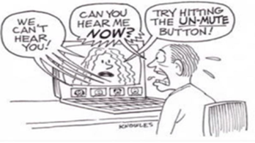
Economics of time: advantages of e-Learning in proportion to the time utilized and the tradeoff between work and studies
Globalization has facilitated e-commerce from any place to any place in the world, at the convenience of one’s home or organization, together with a significant reduction in time required. However academic institutions are lagging behind. The COVID-19 period raises the need for the academic establishment to adapt to the new reality and the advantages of technological modernization in the 21st century. The research findings also indicate students’ expectations of the lecturers in the digital era. In order to succeed, e-Learning requires pedagogic organizational approaches adapted to the digital platform and a perception of learning as a consumer product that lecturers must provide.

Slide 15
Economics of time: advantages of e-Learning in proportion to the time utilized and the tradeoff between work and studies
All researches findings show that it is necessary for policy makers in higher education and academic institutions to hold a thorough discussion of study time at the campus, the distinction between virtual and actual in the stages of learning, by type of course, year of studies, student characteristics, faculties – and challenges and ways of coping with new circumstances, where time is in high demand.

Slide 16
Why is this important? From theory to practice
A conceptual change in students’ responsibility for learning and a change in instructors’ responsibility to orient teaching designed to guide independent, investigative learners who are responsible for their own learning
Some ideas for pedagogical improvements:
Zoom-based meetings for learning communities, and one-to-one Zoom meetings (attendance: the case of the disappearing student? Ask for advance notice of non-attendance, ask to turn on cameras and audio….).
Pay attention to the teacher’s position and distance (role model, closeness, turning remote learning into learning among people who are near)

Slide 17

Why is this important? From theory to practice
Give room for students’ contributions
Make a student the chat manager - assign responsibility and create a partnership. Order of speakers/respondents, start on time
Connect to Moodle
Orient teaching to the group’s profile – year in program, type of course, size of group
Invite colleagues and guest lecturers
Pay attention to students’ physical, mental readiness and health
Any more ideas?

Slide 18
Academic teaching - goals
Social and technological changes – The future academic study experience will differ from that familiar to us from the traditional university and therefore we must plan and prepare in order to maintain a competitive edge in a growing market.
Maintaining an edge in a computer-mediated market requires much more than simply “planting” materials in a website or transferring materials from a regular learning environment to a distance learning environment.
Our goal:
What? To assimilate and evaluate different methods of computer-mediated learning
Where? On campus and in distant locations
Why? Effective achievement of learning goals, efficient utilization of resources, convenience for students, and accessibility by a wide variety of students
For whom? Segmentation of students on the campus and beyond
When? During the course? Beyond the course hours?

Slide 19
Does Technology change Teaching & learning?
Technology is only the means
The most efficient means for Teaching & Learning are the Teachers / Lectureres
Digital Pedagogues: must understand the new opportunities inherent in the technological world for designing learning environments that will cope with increasingly diverse and ethical tasks (Wadmany, 2018)

Slide 20
How to Improve Lecturers’ Teaching & Learning Skills and abilities in the Digital Age?
Adopt new pedagogies that are uniquely suited to the new technologies
New programs should be developed to guide the adoption of the new digital tools as an integral part of teaching practice and not as an external aid that merely supplement teaching & learning
Online Learning cannot be “copy-paste” of frontal learning techniques to online platforms: It requires a distinct pedagogy:
Rethink the content, pedagogy, learning methods and
evaluation methods, in order to reduce the major gap in
the learning skills acquired in a traditional classroom
versus a virtual one

Slide 21
Digital Learning as a Change Agent
New technologies lead change
Informed use of technologies will help academic institutions retain their competitive edge as leading universities with a personal approach

Slide 22

Zoom-supported teaching

Slide 23


Zoom – are we ready?
“Zoom teaching” requires time and effort to develop and update materials, otherwise – learning will quickly become irrelevant.

Slide 24
Zoom – do we have the skills?
Most lecturers do not have the skills.
The success of “zoom teaching” depends on three skills (at minimum):
Knowledge of the studied discipline
Pedagogic – instruction-related knowledge
Familiarity with the technology.

Slide 25
Computer-mediated teaching – in theory and in practice
According to Coben (1986) the technology failed:
Attempts to produce “teacher-proof” means of learning
Lack of understanding that the most efficient means for learning are the teachers

Slide 26
Zoom Learning as a Change Agent
New technologies lead change
Informed use of technologies will help academic institutions retain their competitive edge as leading universities with a personal approach

Slide 27
Benefits of ZOOM Learning
Added value for institution | Added Value for students | Feature
Expands target markets – Allows institution to increase student population in Israel & abroad, without investing resources, e.g., in building more classrooms | Extends opportunities for learning by creating continuous contact with the course that goes beyond class time | Learning – any time, any place

Slide 28
Benefits of ZOOM Learning
Added value for institution | Added Value for students | Feature
In-depth information processing, development of case-based reasoning skills, bridge between theory & the field. | Collaborative learning offers innovative teaching methods | Collaborative learning in virtual communities

Slide 29
Benefits of ZOOM Learning
Added value for institution | Added Value for students | Feature
Raises quality of course materials & standards Standardization facilitates quality control & assessment | Improved quality of materials & course standards Clarity of information is independent of lecturer or instructor | Standardization of learning materials

Slide 30
Benefits of ZOOM Learning
Added value for institution | Added Value for students | Feature
Courses are updated continuously based on students’ changing needs | Real time access to updated materials & information | Real time updates

Slide 31
Benefits of ZOOM Learning
Added value for institution | Added Value for Students | Feature
Increased homogeneity of classes - Allows instructors to ensure that all students begin the course at the same level | Opportunity to practice & receive real time feedback | Interactive learning

Slide 32
Benefits of ZOOM Learning
Added value for institution | Added Value for Students | Feature
Allows response to additional groups through the use of additional channels of input – sound, animation, visuals, graphics, illustrations. | Allows students to use channel best suited to their individual needs and learning styles. Facilitates memory retention | Multi-modal Representation of knowledge

Slide 33
Benefits of ZOOM Learning
Added value for institution | Added Value for Students | Feature
Meets needs of students who are temporarily unable to attend classes on campus (reserve duty, maternity leave, illness) | Allows customization of the pace of learning. Database of lectures allows students to revise if and when they wish, at their convenience | Self-paced learning

Slide 34
Benefits of ZOOM Learning
Added value for institution | Added Value for Students | Feature
Real time picture of teaching and learning at the institution: Allows identification of instructors who need additional training | Students receive immediate feedback; prevents development of “gaps” | Real time tracking of student learning

Slide 35
Benefits of ZOOM Learning
Added value for institution | Added Value for Students | Feature
Extended learning objectives: Teacher as guide and facilitator. Emphasis moves from developing knowledge to developing skills of application and analysis; Guidance & development of new methods to promote learning | Emphasis on application of knowledge, case analysis, synthesis | Clear distinction between course aims: knowledge or skills

Slide 36
“Know that this is why you were given two ears and one tongue – so that you should listen more than speak”
R. Avraham ben Hasdai, from “The Prince and the Monk”, Spain, 13th century
Good luck
d.nitza@ariel.ac.il

Slide 37
Thank you!
Ariel University, Israel

