Slide 1


A special approach to students with learning difficulties - the experience of Ariel University
Prof. Y. Ribakov
Inclusive Processes in International Educational Environment, Stavropol, November14-15 , 2018

Slide 2

Made in Israel
IP-telephony (Vocal Tec)
Files compression technology ZIP (Technion)
USB devices (M-Systems)
ICQ (4 young Israeli IT developers)
etc.

Slide 3
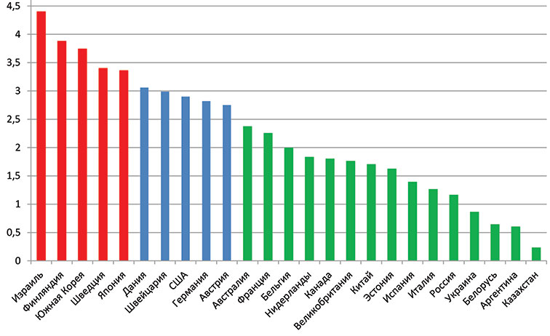
Вложения Израиля в науку (% от ВВП)

Slide 4

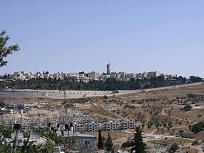
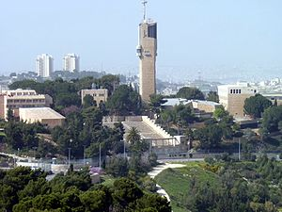
Hebrew University

Slide 5
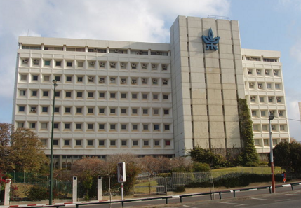
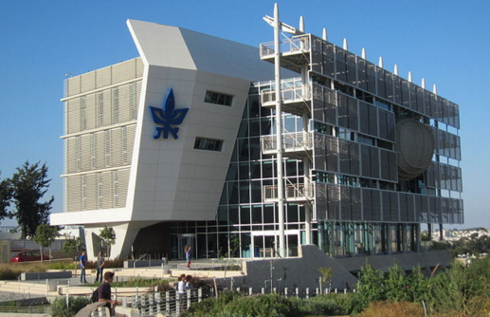
Tel Aviv University

Slide 6
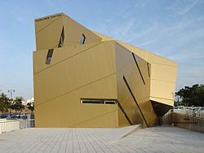
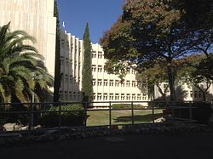
Bar Ilan University

Slide 7
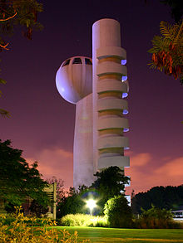
Weizman Institute

Slide 8


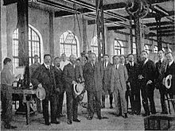
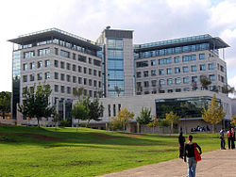
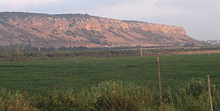

Slide 9

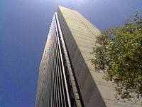
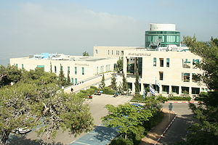
Haifa University

Slide 10
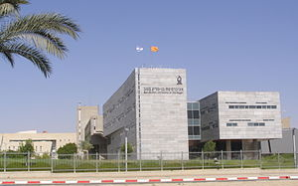
Ben Gurion University

Slide 11
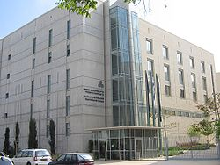
Open University

Slide 12
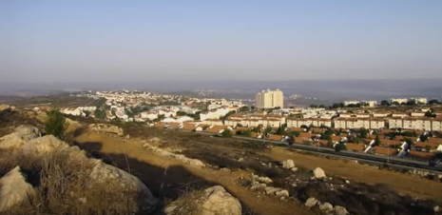
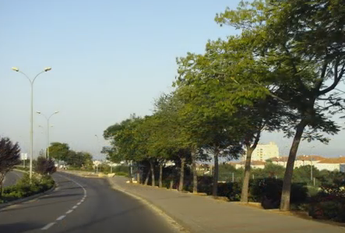
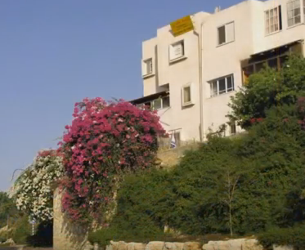

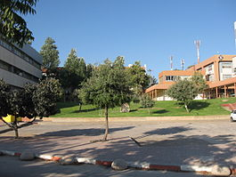
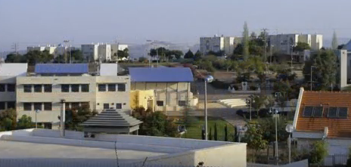
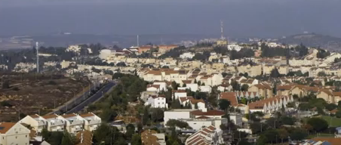
Ariel

Slide 13
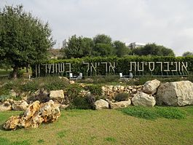
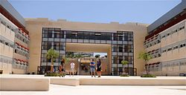
Ariel University
Established in 1982.
26 departments
More than 15 000 students.
Main aim – high quality of education and professionalism.
The alumni work at leading Israel companies, in industry, in the field of research and development.

Slide 14
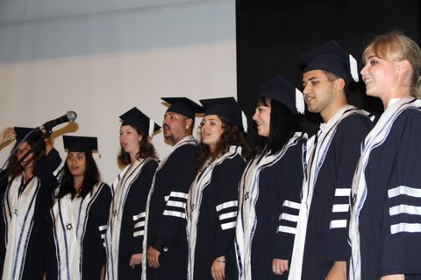


Slide 15
ReWalk – an exoskeleton that allows people with paralysis of the lower limbs to walk
ReWalk using special sensors determines deviations in a person’s equilibrium, and then transforms them into impulses that normalize the movements, allowing a person to walk or stand.

Slide 16
Silentium – active noise filtering
Quicktionary – pen-translator
Umoove – control by eye
PillCam – pill camera
Copacson – first cure against sclerosis
Medigus – the world's smallest video camera
Ola Mundo – the world's first application for autists’ communication

Slide 17
OrCam – Google Glasses for the blind
allows to recognize and voice any text found in everyday life. Built-in camera of eyeglasses scans the surrounding space in the direction indicated by the owner and recognizes the subject. Interaction between eyeglasses and the user is through the audio interface. The sound is transmitted through the head bones, which makes it absolutely inaudible to others and improves the sound quality.

Slide 18


Academic Education for Students with Disabilities
Today there is a strong need to help students with disabilities to be fully involved in the life of modern society. At the same time, availability of academic education for students with learning difficulties is important.

Slide 19
Classification of Disabilities
Germany:
- physical,
- psychic,
- mental,
- combining several types.
Belgium:
- light degree of mental retardation;
- severe degree of mental retardation;
- emotional disorders;
- limited physical capabilities;
- congenital diseases;
- hearing impairment;
- visual impairment;
- dyslexia, dyscalculia, dysphasia

Slide 20
USA and Sweden:
visual impairment;
hearing impairment;
disorders of the musculoskeletal system;
mental disorders;
difficulties in learning
UK:
dyslexia;
latent diseases (diabetes, epilepsy, asthma);
mental disorder;
hearing impairment;
visual impairment;
disorders of the musculoskeletal system

Slide 21


Allocation of learning difficulties (dyslexia, dyscalculia, dysphasia) is typical.
USA (1990) 10.3% of students at universities have learning difficulties.
Following Greenberg and Laser (2010) in Israel there are about 3.4% of students with learning difficulties at universities and colleges.

Slide 22
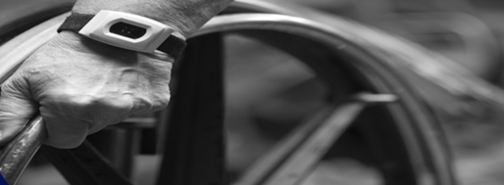
Rehabilitation Department
at the National Insurance
Institute of Israel approves
programs for rehabilitation
by academic education for persons with general disability, traumatism at work, etc. There is also a program of the Ministry of Defense.
Main aspects in academic education for students with learning difficulties:
importance of a database on integration of people with disabilities into academic education;
the right to higher education is guaranteed by existing rehabilitation law;
students with disabilities require preference and accessibility in higher education.

Slide 23

Tracks to higher education
The admission threshold to higher education is mostly related to the matriculation grades and the psychometric test score.
There are special preparatory courses for students with learning disabilities.

Slide 24

For people with disabilities admission to university is often the first time in their lives they leave the family unit, the first time they leave the "disability word" from the
surrounding
umbrella and start
an independent
life that includes
autonomous
management of
their lives.

Slide 25

The disability can be equal, the functional disability is similar but the personal and family background and the tools are different. This leads to the need to prepare for each student a unique and personal “suit” in registration, admission, setting during the initial stages of learning which requires proper orientation and contact with faculty and staff.

Slide 26
Physical accessibility
Following the Law of Equal Rights for People with Disabilities (1998) all those providing services to the public, including higher education services.
Requirements for physical accessibility, include infrastructure, buildings, transportation, public areas, sport, culture, tourism, etc.

Slide 27
Accessibility Service
Some of the barriers and difficulties for such students are related to services essential for integration at the university.
Registration and acceptance:
General website of the university, faculty or department Information and registration booklet, telephone response
Hearing problems - difficulty in receiving telephone information
Visual problems - difficulty in obtaining visual information
Cognitive problems - use of spoken or written language
Is there a need to submit disability information?

Slide 28
Current student information
Examinations and grades, students' personal information, computerized information stands, orientation maps at the campus
For example, if we announce that an examination is cancelled in the Internet, what is the accessibility of the information to students with visual problems?
Is the height of the service points relevant for those who are sitting in a wheelchair?

Slide 29
Flexibility to make changes in distribution of rooms according to accessibility requirements.
Ads for unique needs like giving the students with hearing problems a tutor without beard.
A person with a different cognitive ability or mental disability may need personal consulting rather in a group.
The consulting process duration and the search for the material should be extended and flexible.

Slide 30
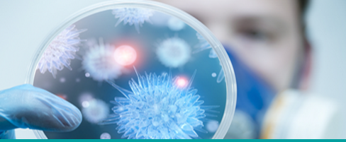
Academic accessibility
How instructional materials, teaching aids, assignments, and exams are accessible to students with disabilities?
Exams
The use during examination additional material that is specially adapted to the learning difficulty.
Personal help, reading, oral test, a test with an alternative structure, a recorded version of the exam, evaluation of the solution process and not just to the final result.
Exercises, projects, diploma work
- organizing timetables,
dependence on others to perform tasks,
the need to postpone the
submission deadline.

Slide 31

Learning Disabilities Diagnosis Institute
The diagnosis is performed in three sessions: two sessions of about 3 h each, and one half hour meeting with an expert diagnostician for feedback on the results of the diagnosis and their significance.
The work is carried out by a team of professional learning difficulty experts, working in collaboration, brainstorming, joint creation and holistic vision of the patient, his difficulties and
welfare, over time.

Slide 32

The Student Service Center provides the campus population with individual and discrete psychological services. The treatment environment is protective, safe, confidential and supportive. The treatment is carried out by an expert clinical psychologist, authorized to treat and advise on mental and emotional problems

Slide 33
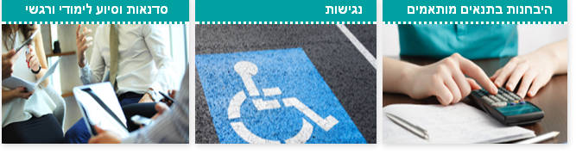
Interdisciplinary support section for the students
Seminars, educational and emotional assistance
Testing under adapted conditions
Accessibility

Slide 34
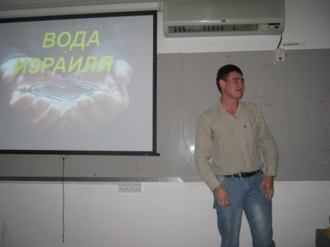
The support section offers many services for students with learning difficulties / disabilities.
Teaching support services for the students include:
learning skills seminars in basic courses,
a seminar for learning skills in real subjects,
a seminar for overcoming pressure and anxiety at exams,
educational mentoring,
marathons before exams,
teaching and professional classes in real and human subjects,
guidance in writing seminar papers,
additional classes in English.

Slide 35
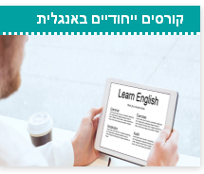
Special courses in English
A course for an academic exemption level in English, adapted to students with special needs The course is characterized by a personal attitude that is reflected in a small number of students in the class.
A special software is used in the lessons (headphones are required).
The exams questions are adjusted so that the questions appear in the context of the relevant paragraph.

Slide 36

Assistive technology
Babylon dictionary (electronic dictionary / digital electronic dictionary )
After a thorough examination of various Hebrew-English-Hebrew dictionaries that exist in the market and in light of the recommendation of lecturers and students, we have chosen and purchased several electronic dictionaries of this type, since it covers the widest vocabulary in relation to other dictionaries.
Laptop
English reading software
Closed Circuit TV is a magnification tool for students with visual problems

Slide 37
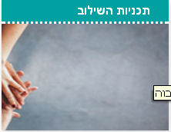
Integration Programs
A program for students on the high functioning autistic basis
Support and guidance for program participants and mentors.
Accommodation arrangements in the dorms with an accompanying tutor.
Support by providing tools for effective learning.
Adjustments of learning process and examinations.
Helping in contacting faculty and students. Support and personal psychological care. Seminars for improving teaching skills and self-functioning.
A supportive social system. Contact with the community and government offices and with employment agencies.

Slide 38


Success
The graduates are successfully employed.
The holders of the undergraduate degrees continue to graduate studies at universities in Israel.
Many of the program's participants and graduates received a certificate of excellence for academic achievements.
The participants and their parents report on feeling independence, development, personal and learning success, significant improvement in functioning, social relationships, as well as a sense of value and self-confidence.

Slide 39

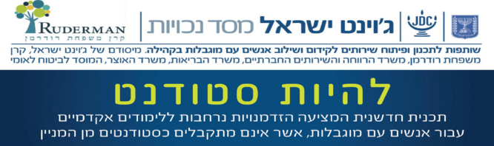

The program offers academic education possibilities for people that are not accepted as full-time students. It is possible to select a track for studying a wide variety of courses taught in the campus, to “taste” one or more academic or preparatory courses. The program is individual and adapted to each participant.

Slide 40
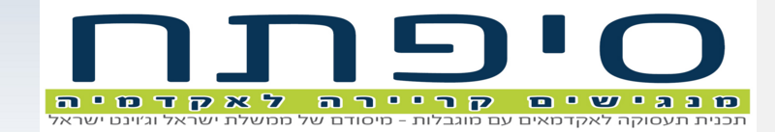
The “Siftach” program promotes and facilitates employment and career opportunities for students and academics with disabilities.
It works in cooperation with the Student Service Center and Career Management Center at the University.
“Siftach”, founded by the Ministry of Labor and Welfare and Joint-Israel, helps students and fresh graduates.
With 20% disability or more, "Siftach" allows acquiring tools and skills for job search and integration in a position suitable for education and skills.

Slide 41
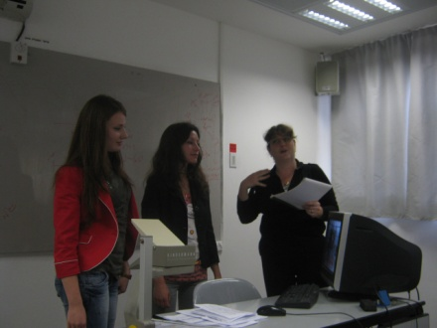
Personal treatment by the program staff, experts in the field of
employment of people with disabilities. - Employment training and preparation for the work world: writing
a CV, preparation for job interview, assistance in locating relevant
jobs, clarifying the need for workplace adjustments and presenting
them to employer. Connecting and mediating between the participants of the program, various departments and services at the university that can assist in the employment and academic aspects.

Slide 42
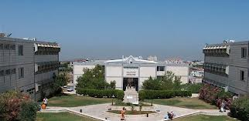
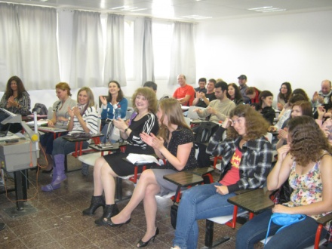
Rehabilitation and socialization of people with disabilities should start from early age. There is a system of special education in Israel starting from special kindergartens and schools.
One of the rehabilitation methods is sensory integration. We have organized three international seminars “SENSORY-MOTORIC NTEGRATION: BACK TO THE SOURCES” to teach specialists from various countries to use
this method. The seminars
were organized in Russian,
they gained popularity in
the Russian-speaking
community of specialists
working with children with
special needs.

Slide 43

Welcome !

Slide 44


Thank you very much !

