Slide 1

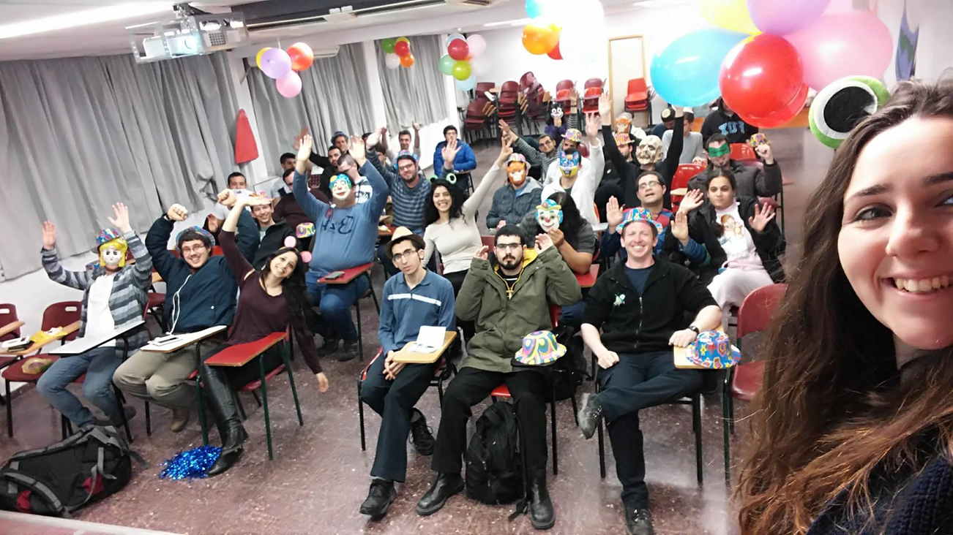
Attitudes of students and faculty to the integration of high functioning students on the autistic spectrum in Israeli higher education (ASD = Autism Spectrum Disorder) Prof. Nitza Davidovitch & Alona Ponomaryova, PhD student

Slide 2
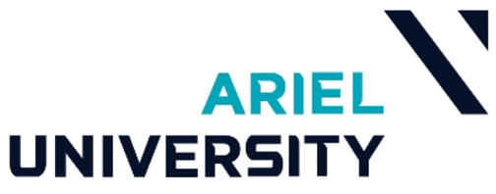
Introduction
Israel state has been under a process of change in its attitude toward people on the autistic spectrum.
The main change reflected by the recognition of their basic right to a full and productive life accompanied by self realization while integrating them into all areas of human endeavor (Ward & Stewart, 2008).

Slide 3
Theoretical Background
Autism
Autism is a neurological developmental disability (Narasingharao, Pradhan & Navaneetham, 2017).
The autistic spectrum is very wide - from severe to almost normal level (Volkmar, 2013).
Autism characterized by severe and extensive damage in three areas of development: social, communicative and behavioral functioning (Delfos, 2005).

Slide 4
Theoretical Background
Autism
Social and communicative functioning:
Communication deficiencies and lack of social interaction.
Impaired ability to receive messages from others and deficit in the ability to develop mutual relationships in a proper manner
Behavioral functioning
Repetitive behaviors, aggression, irritability, disobedience, and self-harm.
Inadequate sensory integration (Delfos, 2005.,Narasingharao, Pradhan & Navaneetham, 2017).

Slide 5
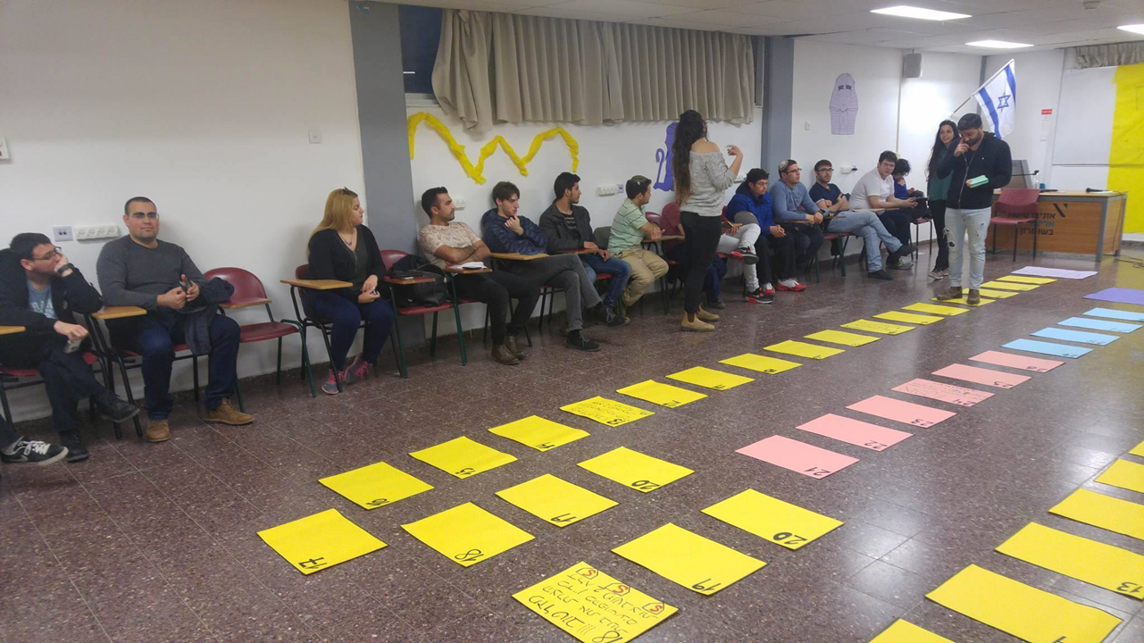
Theoretical Background
Integration
A psychological concept that relates to the creation of a true relationship between a person in need and a "normal" person.
In the field of education, it is customary to regard integration as a concept that includes the following elements:
Integration
Diversity
Inclusion
Participation

Slide 6
Theoretical Background
Integration
The acceptance of the target culture by the minority group, while preserving the origin culture (Berry, 1991.,Tinto, 1975).
Diversity
The social and cultural composition of students in educational institutions (Dey Hurtado, Gurin, 2002).

Slide 7
Theoretical Background
Inclusion
Expansion of higher education As part of a change in the global system.
In the past, inclusion was an option to enter the system for groups that were not part of it (Ross, 2003).
Participation
Classification of health and disability states, to explain community integration in various areas of life (International Classification of Functioning, Disability and Health, 2001).

Slide 8
Theoretical Background
The Equality Law (1998)
This law defines the rights of people with disabilities (for example, in the field of employment, education, public transportation) and the obligation of Israeli society to protect these rights.
Similar processes have taken place in recent decades in the majority of developed countries in the world (Levinger & Klein, 2002).

Slide 9
Theoretical Background
Social Integration
The individual most basic need is acceptance by the society (Pleshkes, 1993, Sheinin, Reiter & Tirosh, 1994).
A person's limitations largely determine his social status, especially if his disability is apparent (Reiter, Schanin & Tirosh, 1998).
The integration of people on the autistic spectrum in the community has developed, leading to new initiatives (Beit, Issie & Shapiro, 2013).

Slide 10
Theoretical Background
Integration In Higher Education Institutions
Integration in higher education measured by the following terms:
Enrollment
The entry of minorities into higher education caused by social tendencies and educational performance in previous stage of education (Mingle, 1987).

Slide 11
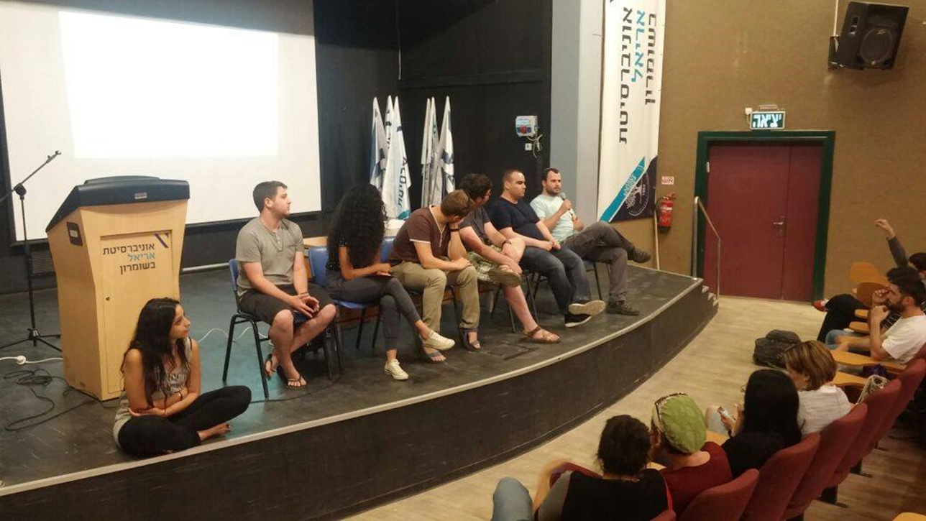
Theoretical Background
Integration In Higher Education Institutions
Adjustment
Measured by the academic, social and personal emotional level (Baker & Siryk, 1984).
Persistence
Attrition
Aspiration
Degree receiving and intending to find a job.
Dropout

Slide 12
Theoretical Background
Integration Of High Functioning ASD Students In Higher Education
Higher education is an essential tool for society development by producing and transferring the knowledge that shape it.
Since it is a key to personal, social, and employment integration, it is of great importance to make this system accessible (Avisar, 2010).

Slide 13
Theoretical Background
Integration Of High Functioning ASD Students In Higher Education
Students who are on the high functioning autistic spectrum (HFA) often have difficulty coping with the challenges they face as independent individuals (Palmer, 2006).
Therefore, a comprehensive integration in the social and educational fields of these students is essential for their success in the academy.

Slide 14
Theoretical Background
Integration Of High Functioning ASD Students In Higher Education
Integration of ASD students in higher education in Israel began as a local project and today academic institutions adopt this idea as part of academic involvement in the community (Ministry of Education website, Special Education Division on models for integration of children with autism).
Integration final product measured in terms of graduation.

Slide 15
Ariel’s University Integration Program For Students On The High Functioning Autistic Spectrum
The university sees itself as committed to provide the needs of the students on the autistic spectrum.
In order to help them reach their full potential, Ariel university established a special and unique integration program for students on the high functioning autistic spectrum.

Slide 16
Ariel’s University Integration Program For Students On The High Functioning Autistic Spectrum
Since the program was founded in 2008, the number of it's students is growing every year.
The success of the program can be demonstrate with:
Growth in the number of participants.
High level of excellence among the ASD students.
Parents' reports of high satisfaction.

Slide 17
Ariel’s University Integration Program For Students On The High Functioning Autistic Spectrum
Goals:
To provide equal opportunities.
To access the higher education, and give them the basic opportunity to acquire a degree.
To provide additional resources, that will help them reach that goal and enrich their abilities.

Slide 18
Ariel’s University Integration Program
The Assistance That Is Given By The Program Includes:
Accompanying and supporting the social, emotional and personal aspects throughout the day:
In the social & emotional aspect: Weekly personal conversations that raise difficulties and feelings, while thinking of possible solutions.
In the social aspect:
Three weekly meetings of 'quality time' - for talking, studying, eating together or do any other activity.
A large social activity takes place once a week with all the participants (mentors, ASD students).

Slide 19
Ariel’s University Integration Program
The Assistance That Is Given By The Program Includes:
Accompanying and supporting the learning aspects:
A professional team: social workers, psychologists, remedial teaching and etc.
In the educational aspect - Teaching tools, learning skills, customized schedule as needed, private tutoring and etc.
Moreover, the support does not end after receiving the diploma, but continues with assistance work placement, and continuing education for those interested in it.

Slide 20
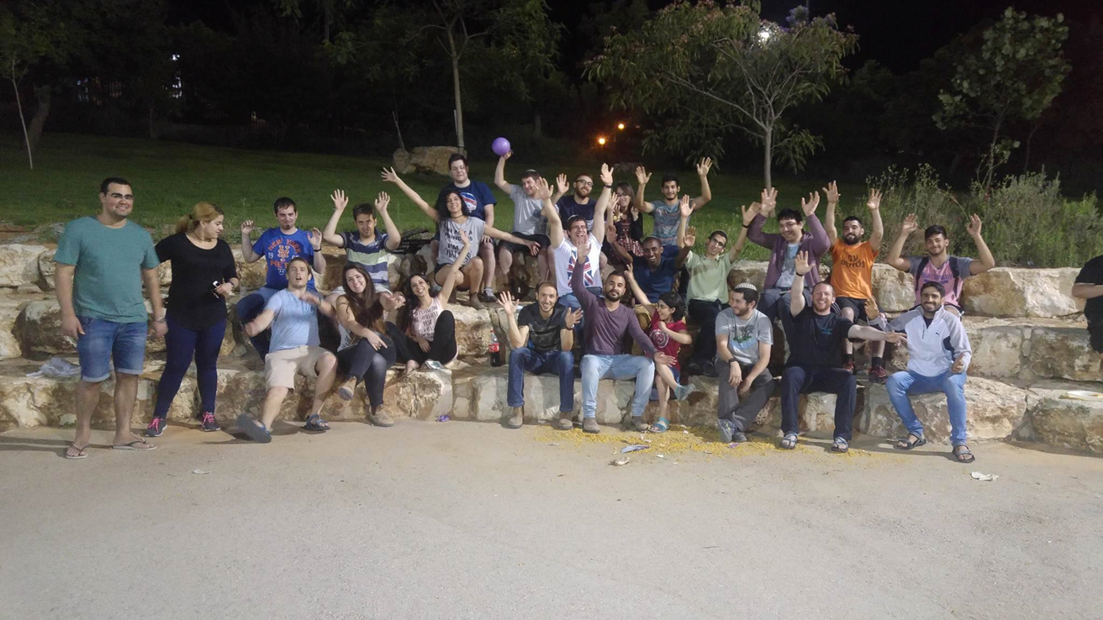
About The Study
This study focused on the high functioning autistic spectrum students, who are part of the integration program at Ariel University.
This study is an evaluation study
of this program.

Slide 21
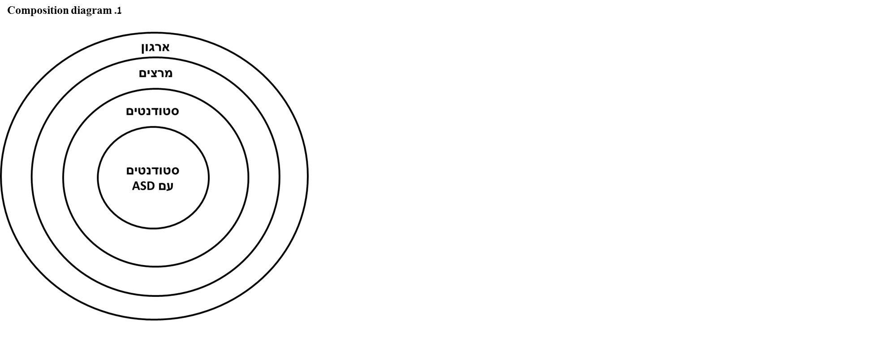

Slide 22
תרשים .1 מפת המחקר
פרופיל הסטודנטים
1. גורמי השפעה אישיים
- גיל, מין, פקולטה;
- הכרות עם התחום ליקוי למידה;
- הכרות עם תחום ASD
- תפיסת חוללות עצמית בלמידה;
- תפיסת "רגשות" כלפי סטודנטים עם ASD
-תפיסת השתלבות לימודית חברתית
- השתתפות בתכנית שילוב לסטודנטים עם ASD (לחונכים)
2. מאפייני הוראה
- תפיסת שיטות הוראה;
- תפיסת מעורבות מרצה בקורס;
3. גורמי השפעה מוסדית:
- תפיסת סיוע וקבלה מוסדית;
- תפיסת אקלים לימודי-חברתי.
פרופיל סטודנט על הרצף אוטיסטי בתפקוד גבוה
1. גורמי השפעה אישיים
- גיל, מין, פקולטה;
- ציונים;
- מידת שביעות רצון וסיפוק אישי;
- תפיסת חוללות עצמית בלמידה;
- מחשבה על תכנית שילוב;
- תפיסת השתלבות לימודית-חברתית
- סיום התואר;
- המשך לתארים מתקדמים;
2. מאפייני הוראה:
- תפיסת שיטות הוראה;
- תפיסת מעורבות מרצה בקורס;
3. גורמי השפעה מוסדית:
- תפיסת סיוע וקבלה מוסדית;
- תפיסת אקלים לימודי-חברתי.
פרופיל מרצה
1. גורמי השפעה אישים
- גיל, מין, ותק הוראה;
- הכרות עם התחום ליקוי למידה
- הכרות עם תחום ASD
- תפיסת "רגשות" כלפי סטודנטים עם ASD
- מוכנות לשיתוף פעולה;
2. מאפייני הוראה:
- תפיסת שיטות הוראה;
- תפיסת מעורבות מרצה בקורס;
- רצון לקבלת ידע בתחום ASD
- תפיסת חוללות עצמית בהוראה;
3. גורמי השפעה מוסדית:
- תפיסת סיוע וקבלה מוסדית;
- תפיסת אקלים לימודי-חברתי.
הארגון
1. סוג הארגון- (חקר מקרה: אוניברסיטת אריאל)
2. אוריינטציה ארגונית (הוראה, מחקר, שירות לקהילה)
3. ניסיון ארגוני-אקדמי בתהליך שילוב של סטודנטים אוטיסטים בתפקוד גבוה (קיים)
משתניים תלויים להצלחה בהשתלבות (מרכיבי התאמה):
1. אווירה סובלנית כלפי הסטודנטים
2. שיטות מתקדמות בהוראת סטודנטים

Slide 23
About The Study
Method
Participants:
30 students on the high functioning autistic spectrum.
27 students who are the tutors for students on the high functioning autistic spectrum.
103 lecturers from the institute.
526 students that have no association to the program.
N = 686.

Slide 24
About The Study
Method
Tools:
A Questionnaire called "The Integration of Students in the Autistic Sequence in Higher Education in Israel".
Two supplementary questionnaires were developed.
The study was approved by the Institutional Ethics Committee.
The subjects were also asked to fill in a number of demographic data, such as sex, year of birth, country of birth and field of study.

Slide 25
About The Study
Method
Tools:
The questionnaire that was divided to the ASD students, didn't include an introduction, because of consideration to avoid overload information and therefore confusion.
In addition, their questionnaire was transformed to be shorter and more accessible.

Slide 26
About The Study
Method
Procedure:
All groups, except the ASD group, could fill out the questionnaire either manually or computerized
The ASD group was given the questionnaires individually.
Although the questionnaire that was given to them was adjusted, they did show difficulty filling them.

Slide 27
About The Study
Hypotheses (Based On Literature Research And Field):
There is a correlation between all students attitudes (with or without tutoring relationship), and the social – educational climate in the academic institution, towards the students on the high functioning autistic spectrum integration.

Slide 28
About The Study
Hypotheses (Based On Literature Research And Field):
There is a correlation between the tutors attitudes, towards the students on the high functioning autistic spectrum perception of self-academic efficacy.
There is a correlation between the personal background (age, acquaintance with autism) and the attitudes of all students toward the integration of students in the autistic spectrum.

Slide 29
Insights From The Field:
The ASD Students – Difficulties And Ways Of Coping:
Trust:
The Difficulty: Most of the ASD students arrive with little trust and High skepticism towards the program and the mentors.
Coping: Time is the best solution for adjustment.

Slide 30
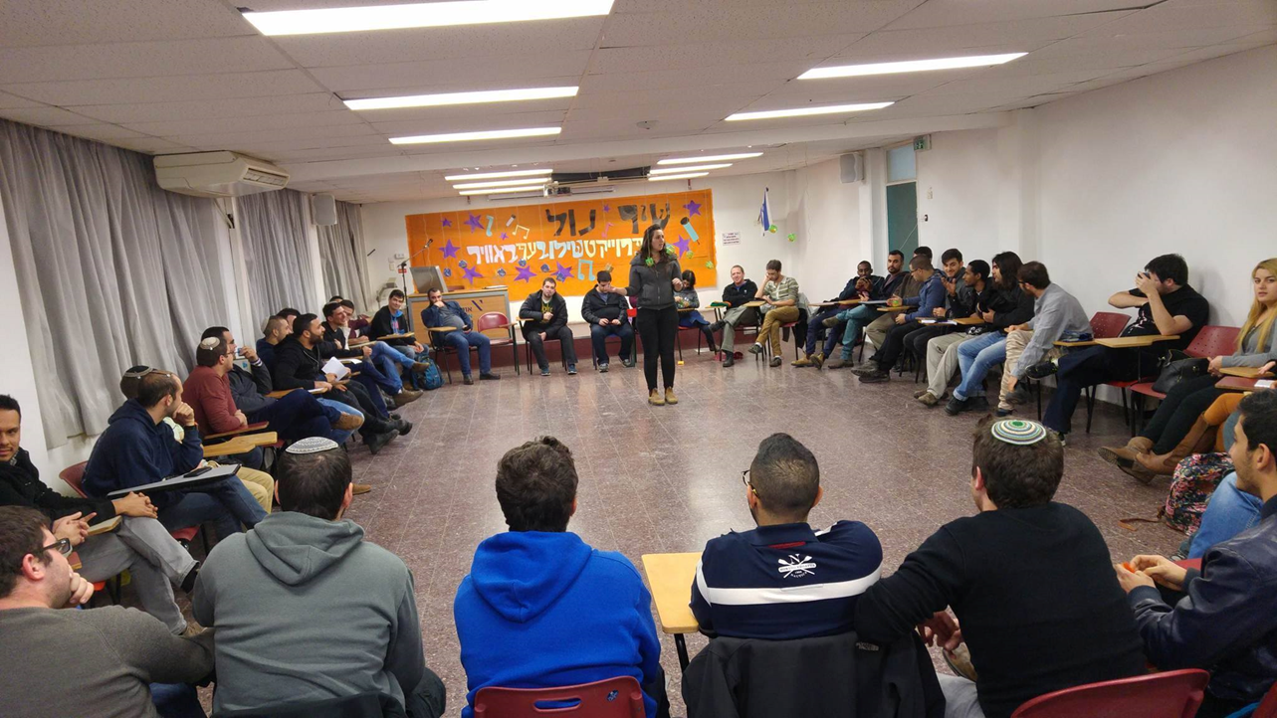
Insights From The Field:
The ASD Students – Difficulties And Ways Of Coping:
Individual Problems:
The Difficulty: ASD student's habits.
Coping: Guidance.

Slide 31
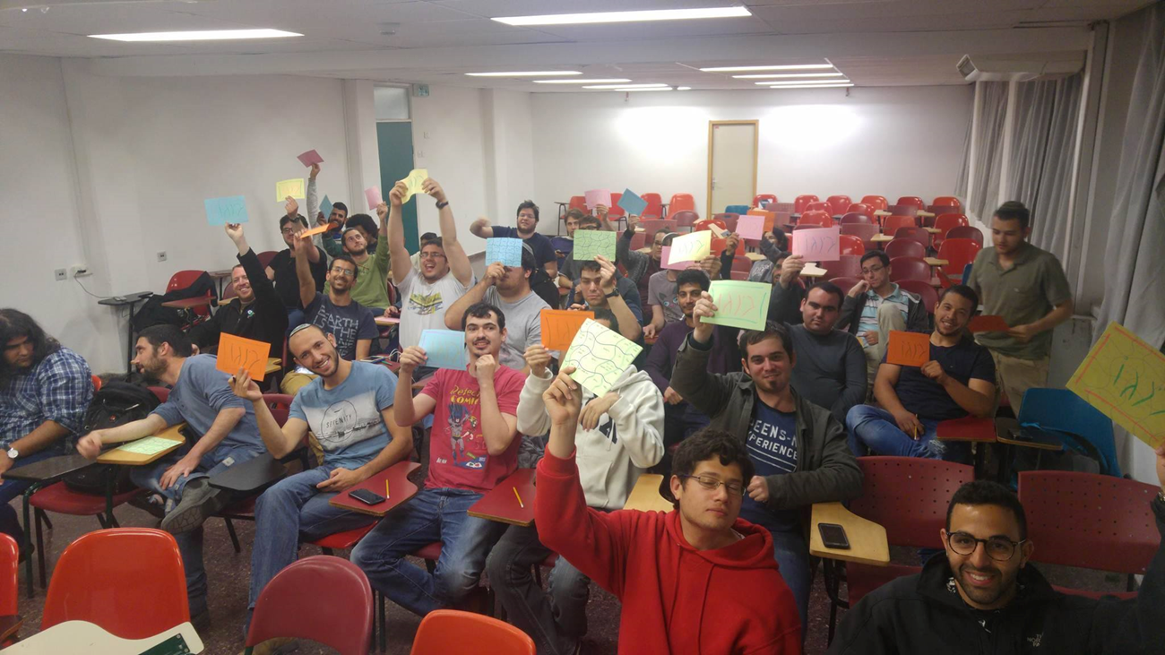
Insights From The Field:
The Tutors – Difficulties And Ways Of Coping:
Overload:
The Difficulty: All tutors are both students and employees, and also have commitment to the project.
Coping:
Building a "smart" schedule.
Humanity
flexibility

Slide 32
Insights From The Field:
The Tutors – Difficulties And Ways Of Coping:
Individual Problems:
The Difficulty: Each pair (ASD student and tutor) have their own sensitive issues.
Coping:
Weekly personal conversations with the coordinator
Professional guidance.

Slide 33
Insights From The Field:
The program mediates social interactions and simulate Independent life.
Recommendation: The tutors and ASD students guidance should take place before the beginning of school year, in order to coordinate the expectations and to calm all concerns of both sides.

Slide 34
Higher education in Israel in service of society:
University organization support to HFA students-
Lecturers attitudes

Slide 35
Presentation outline
Research motivation
Theory, research literature & aims
The study’s empirical research
- Methodology & Sample
- Findings
Conclusions

Slide 36
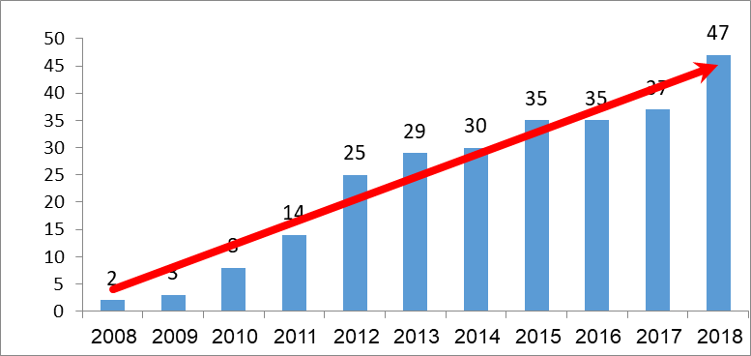
Research motivation. History of the project

Slide 37
Research motivation. Approaches
Existent social approaches to the disabled:
The nursing model (Dymond, 2001).
The medical-scientific model (Reiter, 2017).
The educational-humanistic model (Reiter, 2008, 1992).

Slide 38
Research motivation. Regulatory environment
In recent years, the State of Israel is undergoing a change in its attitude toward individuals with autism spectrum disorder (Avisar, 2010, Officer & Groce, 2010; Ward & Strewart, 2009).
The Equal Rights for People with Disabilities Law, 1998.
The Convention on the Rights of Persons with Disabilities (CRPD), which was adopted by the UN, 2006.
Israel ratified the CRPD in September 2012, but in practice included its principles in the Equal Rights for People with Disabilities Law.
Council for Higher Education, Student Rights Law, 2007.

Slide 39
What is Autism?
ASD is a neuro-developmental disability, which affects three main functions:
Behavioral
Social
Communication

Slide 40
Employment Statistics
According to the Israeli National Society for Autism:
61% diagnosed as ASD are supported by their families;
40% live with their parents as adults;
only 15% work and support themselves.

Slide 41
Theoretical Background
Higher education is an essential instrument of social development, and of developing and transmitting formative knowledge. As a key to individual integration in society and in the workplace, the accessibility of the higher education system in Israel is of enormous importance (Avisar, 2010).

Slide 42
Theoretical Background
Organizational support and assistance (Reiter, 2008; Berry, 1991; Vaandrager & Koelen, 2013)
2. Teaching and a tolerant atmosphere (Hativa, 2002; Davidovich, 2010).

Slide 43
The aims of the study
1. To examine the university’s ability to contribute to the academic integration of students with HFA by influencing its teaching staff and students.
2. To identify the factors that have a positive impact on how lecturers promote the integration of students with HFA and their connection to the institution’s support system.

Slide 44
Research questions:
1. Will the tolerant atmosphere be more positive when the academic institution is more involved and supportive?
2. Will lecturers make more use of special developed methods for student with HFA when the academic institution is more involved and supportive?
3. Will the tolerant atmosphere in the classroom be more positive and affect students with HFA when (a) the general lecturer involvement in class in the classroom is higher; (b) when the lecturer has positive emotional responses toward students with HFA?

Slide 45
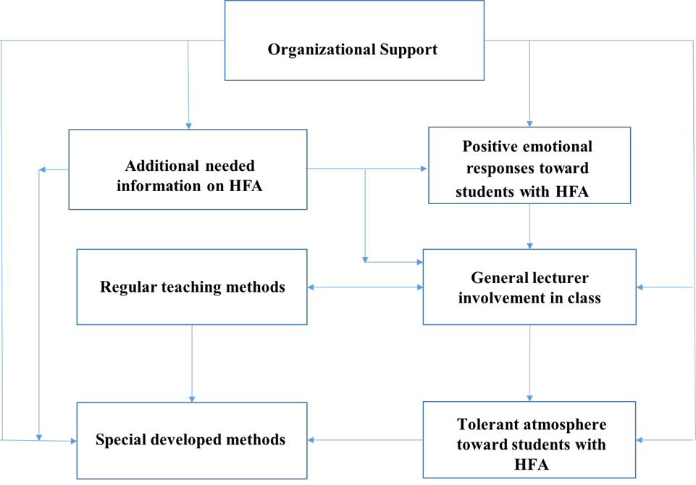
Model of the effect of organizational support on lecturers' attitudes

Slide 46
Methodology and Sample
Measurement: respondents were asked to indicate their level of agreement (five-point scale).
Tools:
A questionnaire “Integration into Higher Education”. Sagy, 2000.
A questionnaire "Social-educational climate". Moss, 1979.
Two supplementary questionnaires “Attitudes of student and teaching staff regarding the integration of HFA student into Higher Education in Israel” were developed.
Motivated Strategies for Learning Questionnaire. Pintrich, 1989.

Slide 47
Sample Participants: 103 lecturers

Slide 48
Statistical procedures
Scales validity: Alfa Cronbach
Model testing: A path analysis was conducted to check the research hypotheses, using Structural Equation Modeling (SEM) based on the maximum likelihood approach
The benefit of using multi-path modeling software is although the results are similar to regression results, multi-path models enable a deeper analysis of the ties between dependent and independent variables and within the group of independent variables, including direct and indirect associations.

Slide 49
Reliability test of factors
Factor | No. of questions | Cronbach’s alpha
Organizational support | 10 | .71
Positive emotional responses toward students with HFA | 5 | .83
Regular teaching methods | 3 | .63
General lecturer involvement in class | 7 | .70
Additional needed information on HFA | 2 | .95
Depended variables:
Tolerant atmosphere toward students with HFA | 3 | .89
Special developed methods | 4 | .77

Slide 50
Results
Model testing: The path analysis results show that the overall fit statistics (goodness of fit measures) exhibit an acceptable level of fit (χ2 value 5.126 (5), χ2/Df = 1.025, p = .401; CFI = .999; NFI= .975; RMSEA= .016)
Figure 1 and Table 1 show the results.

Slide 51
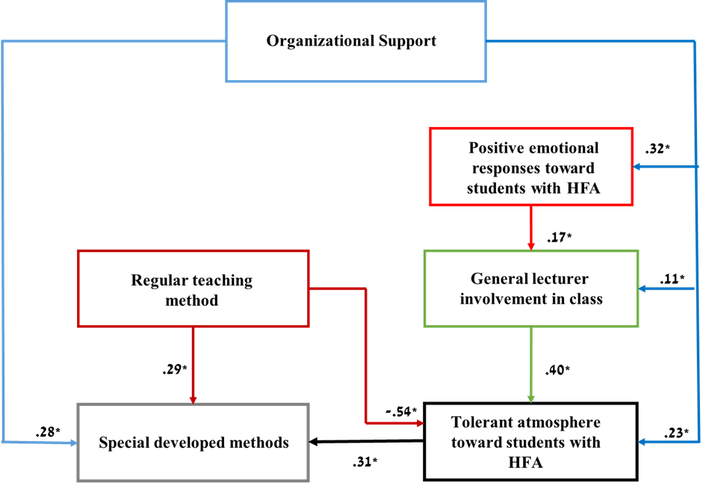
Results of the model – the effect of organizational support on lecturers' attitudes

Slide 52
Results. Direct and indirect correlations in the model
Regression Weights (direct) |  |  | Standardized Effect |  |  | Effect
P | C.R. | Estimate | Indirect | Direct | Total
 |  |  |  |  |  | Atmosphere of tolerance:
<.003 | -2.971 | -.452 | .000 | -.537 | -.537 | Regular teaching methods
<.030 | 2.171 | .539 | .000 | .398 | .398 | General lecturer involvement in class
<.020 | 2.332 | .326 | .065 | .230 | .295 | Organizational support
 |  |  | -.067 | .000 | -.067 | Positive emotional responses toward students with HFA
 |  |  |  |  |  | Special developed methods:
<.001 | 3.200 | .252 | .168 | .287 | .454 | Regular teaching methods
<.001 | -3.268 | -.327 | .000 | -.312 | -.312 | Tolerant atmosphere
<.003 | 2.982 | .410 | -.092 | .276 | .184 | Organizational support
 |  |  | -.124 | .000 | -.124 | General lecturer involvement in class
 |  |  | .021 | .000 | .021 | Positive emotional responses toward students with HFA

Slide 53
Conclusions
The university organization support is an important factor that influences the preferred system for integration, tolerant atmosphere or special developed method.
This influence is performed through lecturers' positive emotions and cognitive desire to be familiar and involved with regular students and HFA students, as well as their teaching capabilities.
The lecturers believe that together with other tools, the best way to help students with HFA is to include organizational support.
Lecturers thinks that their involved in what happens in the classroom affairs positively affects the tolerant atmosphere.

Slide 54
Conclusions
The organization support is also an important factor influencing using special developed methods, but the most important factors is the experience the lecturer has with using regular teaching methods.
The most stimulating result is the negative relation found between the two systems examined in the research for integration students with HFA. The result maybe explained the individual qualifications of the lecturer.

Slide 55
Thank you for your attention!

Slide 56
Inclusion in Education
The disabled person is entitled to experience a normal life, studying the subjects which interest him under the least confining environment. Accordingly the University provides for integration of the students, freedom of choosing their curriculum, studying with all other students, and enjoying our dormitories, along with his social mentor.

Slide 57
Ariel University Support System
Escorting, supporting and guiding the students and mentors
Academic and social mentoring
Academic support with acquiring efficient learning habits
Learning and testing adjustments
Mediating with faculty and fellow students

Slide 58
Master class: Accessibility of Academic Education - comparison study: Russia and Israel
.Planned timetable:
General explanation – 15 min.
Questionnaire – 15 min. (please see the attach files)
Discussion in groups: faculty members, teachers, students – 30 min.
If there is a possibility for students (pupils) – autists to study in a common frame with regular students (pupils)?
If no – why
If yes – if there is a need to prepare teachers to withstand with special problems related to teaching such students (pupils)?
What are the ways allowing to withstand with this at schools and at universities?
If in your opinion regular students will "pay the price" of such common education?
Report of each group leader – 15 min. for each group.
Summarizing and concluding remarks – 15 min.

