Slide 1


Through Inclusive Education to an Inclusive Society In Canada and Russia: Collaborative Innovation for Progressive Change
Presentation By
Don Fuchs, PhD
Professor and Dean Emeritus
Faculty of Social Work
University of Manitoba,
Winnipeg Manitoba, Canada
Developed for Presentation at the NCFU International Conference Inclusive Processes in International Educational Space November 14-15, 2018

Slide 2
Presentation Outline
History Canada Russia Partnership On Inclusive Education
Role of Inclusive Education in Creating an Inclusive Society
Principles of Collaboration for Innovation
Activities, Outputs and Outcomes of Our Collaborative Partnership
Next Steps and Future Direction

Slide 3
History Canada Russia Partnership On Inclusive Education
Partnership was Built on a Previous Winnipeg Stavropol Project the Canada Russia Disability Project (CRDP)
Notes:
Here I am going to the History building on two Previous projects

Slide 4
There Three Regions and Three Partners iin each region
Regions
Stavropol, Moscow, Omsk
Partners
University, Government and Disability NGOs

Slide 5
Outcomes of CRDP:
  1. Developed models for education and preparation of faculty, professionals, community leaders, and adults with disabilities in Disability Studies, Social Work, and Mental Health;
2. Established alternative models for service delivery –
community- based social programs/services and a network
among them; .
3. Contributed to the development and implementation of public
policies which supported reform, and promoted human rights and
better access to services which are reflective of the inclusion of
people with disabilities on federal, regional and local levels (CCDS
2007),

Slide 6
After the CRDP
The CRDP identified the nature and significance of inclusive education in the promotion of Inclusive society. It identified the role of inclusive education in the promotion of social stability and social and economic development.
Over the last decade there has been some significant policy developments in Canada and Russia that have fostered the development of increased the number and type of inclusive education programs.

Slide 7
Role of Inclusive Education in Creating a more Inclusive Society
As learning institutions try to become more effective in promoting Social Inclusion.
Inclusive education requires positive attitudes, teacher education, appropriate resources enabling policy and legislation, family support, inclusive pedagogy universal design of curriculum, leadership community collaboration and an organized and systematic approach.

Slide 8
Current Collaborative Partnership
June 2013 Dr. Valerie Shapovalov Traveled to Winnipeg
Met with Deans of Education and Social Work and Vice-Provost ofInternational Department to Develop a Memorandum of Understanding (MOU)
MOU signed June 26, 2013 by President of University of Manitoba and Rector of NCFU
Notes:
In June of 2013 Dr. Valerie Shapovalov, Vice Rector, NCFU traveled to Winnipeg to explore the possibilities of building on the previous partnership between NCTU and the University of Manitoba. The NCTU and others Universities in Stavropol Krei had recently been amalgamated into one University, the NCFU and they were at looking developing their international partnerships and enhancing their research and scholarship. During his visit, Dr. Shapovalov met with the Deans of the Faculties of Education and Social Work, other faculty members of the Faculty of Education and staff of the Canadian Centre on Disability studies to develop an agreement on areas of mutual interest
After a series of meetings between partners a Memorandum of Understanding (MOU) was signed On June 26, 2013. The Presidents of the North-Caucasus Federal University (NCFU), University of Manitoba and the President of the Board of the Canadian Centre on Disability Studies signed MOU aimed furthering cooperation through academic and educational exchanges of mutual benefit. The partnership was built on an agreed upon collective vision of working through inclusive education to an inclusive society.

Slide 9
Evolution of our current Collaborative project focus

Slide 10
Overview
Where we started in both Canada and russia
What where some issues
What Changed
How change progressed
problems in the change process
Selected inclusive practices

Slide 11
Where we Started
Initially We were using a Cascade Model - Bringing students to segregated services
  institutions
  special schools
  special programs
  special classes
  pull-out to resource room
  pull-aside in regular classroom
  adapted program in regular classroom

Slide 12
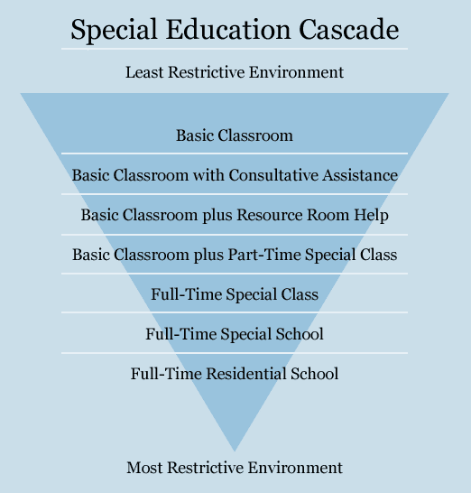
Where we Started
Cascade Model - Bringing students to segregated services

Slide 13
Where we Started
Cascade Model Assumptions
  “impairment” assessments guide placement
  provisions are “categorical”
  special students... in special programs... taught by special teachers... with special training... using a special curriculum... and special materials
  students will “cascade” from most restrictive placement to least restrictive placement
  “special” education will be better

Slide 14
What went wrong with this model
Cascade Model Problems
  “impairment” assessments did not guide instruction
  “categorical” provisions focused on safety, care, therapy, crafts... not education
  segregation lead to devaluation, low expectations
  teachers became isolated from professional peers
  students “cascaded” in the wrong direction...from least to most restrictive placements
  “special” education outcomes were low in all areas: social integration, employment, education level, independent living, access to “good things in life”

Slide 15
What Changed
Response to Intervention (RTI) Model – Bringing services to integrated students
  all students included in regular classroom
  in neighborhood school
  with age-mates
  engaged physically in all school environments
  engaged socially with peers in and out of school
  engaged in the academic work of the classroom

Slide 16
What Changed
Response to Intervention Model Assumptions
  Disability redefined...
    no longer synonymous with impairment
    biological and environmental factors considered
    quality of supports, removal of barriers, inclusive instruction, technology and therapy can reduce/eliminate disability
    seen as “limits to belonging, participation, achievement”
    students with impairments may not be disabled by them
    students without impairments may be disabled by other factors

Slide 17
What Changed
RTI Model Assumptions
  shift away from “impairment” assessments to guide placement decisions
  shift to educational assessments to guide instruction
  assessments and provisions are more holistic (physical, emotional, social, behavioral, academic)
  assessments include environmental factors (quality of... supports, inclusive instruction, technology, therapy, removal of barriers, etc.)

Slide 18
What Changed
RTI Model Assumptions
  Collaborative service delivery
    new role for administrators
    new role for clinicians
    new role for Resource Teachers
    new role for Educational Assistants
    strengthening inclusive pre-service and in-service professional development for teachers

Slide 19
What Changed
RTI Model Assumptions
  Collaborative service delivery
    introduction of co-teaching
    organization of in-school support services team
    introduction of peer supports
    introduction of professional learning communities
    development of school-community partnerships
    strengthening home-school partnership

Slide 20
What Changed
RTI Model Assumptions
  services organized in Tiers
  services are more holistic (student-centered...not discipline-based)
  strengths-based, growth promoting, ability-focused approach
  behavior plans, social-emotional provisions, academic supports are embedded in classroom work
  authentic assessment of learning, for teaching, as feedback, for motivation and self-determination

Slide 21
What Changed
RTI Model Assumptions
  Tier 1 services: Universal Design for Learning (UDL)
    “inclusive” provisions available for all students
    social/emotional learning supports
    academic learning supports
    positive behavior supports
    Resource Teacher – Classroom Teacher collaboration
    Educational Assistant assigned to Classroom Teacher to
    support an inclusive classroom for all students

Slide 22
What Changed
RTI Model Assumptions
  Tier 2 services: Differentiated Instruction (DI)
    “inclusive” provisions available for all students
    instructional objectives: same or equivalent
    instructional methods and supports: differentiated
    instructional outcomes and standards: same or equivalent
    if instructional objectives, outcomes or standards change
    IEP (individual education plan) required

Slide 23
What Changed
RTI Model Assumptions
  Tier 3 services: Intensive Individualized Supports
    IEP (Type 1) – exceptional supports to access the curriculum
    IEP (Type 2) – exceptional supports replace the curriculum
    requires student and family input
    long term, holistic planning required
    “transition” planning required
    inclusive valued social roles and participation emphasized

Slide 24
How Change progressed
inclusion is a “work-in-progress”
international agreements
constitutional reform in Canada
parent advocacy
self-advocacy of people with disabilities
professional advocacy
university research
educational policy development

Slide 25
Problems in the Change process
societal devaluation of people with impairments
attitudinal barriers – underestimation of potential
professional role confusion
inconsistent leadership
resistance to change
belief in a “golden age”
lack of ownership by classroom teachers
over-ownership by “special” educators and Educational Assistants

Slide 26
My sessions this week have focussed on
Universal Design as a tool for Inclusive Education at the level of the
student,
The teacher
The curriculum delivery
Classroom
School

Slide 27
Next Steps
Research and Presentations on Differentiate Instruction and Transition to Employment

